Slide 1
PROBABILITY AND STATISTICS
WEEK 2
Onur Doğan 2016-2017

Slide 2
Today’s Plan
Measures of Variability
Skewness
Z-Scores
Chebyshev’s Theorem
Onur Doğan 2016-2017

Slide 3
Measures of Variability
Range
Quartiles (Quartile Deviation)
Mean Absolute Error (Mean Deviation)
Standard Deviation and Variance
The Coefficient of Variability
Onur Doğan 2016-2017

Slide 4
Range
Range: The difference in value between the highest-valued (Xmax) and the lowest-valued (Xmin) pieces of data:
Range=Xmax - Xmin
Onur Doğan 2016-2017

Slide 5
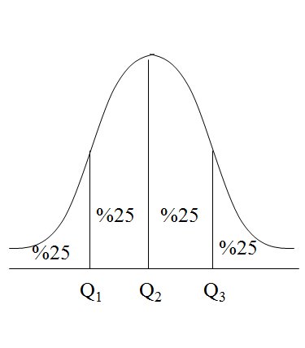
Quartiles
Onur Doğan 2016-2017

Slide 6
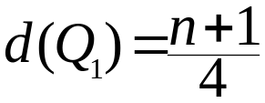
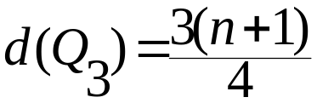
Quartiles
Depth of Q₁ is
Depth of Q₃ is
First quartile/lower quartile (Q₁) splits off the lowest 25% of data from the highest 75%.
Second quartile/median (Q₂) cuts data set in half
Third quartile/upper quartile (Q₃) splits off the highest 25% of data from the lowest 75%.
Interquartile range (IQR) is the difference between the upper and lower quartiles. (IQR = Q₃ - Q₁)
Onur Doğan 2016-2017

Slide 7
Quartiles
Grade of Statistics:
30, 32, 42, 56, 61, 68, 79, 82, 88, 90, 98
Grade of Maths:
  10, 52, 80, 81, 81, 86, 89, 92, 97, 98, 98
Onur Doğan 2016-2017

Slide 8

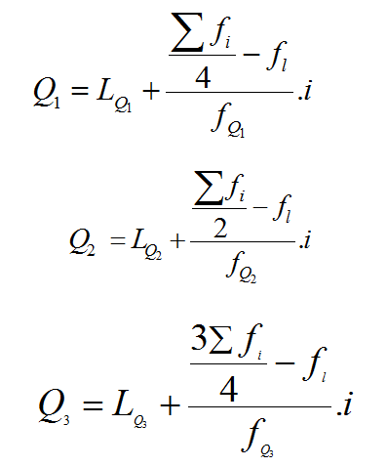
Quartiles (Grouped data)
Onur Doğan 2016-2017

Slide 9
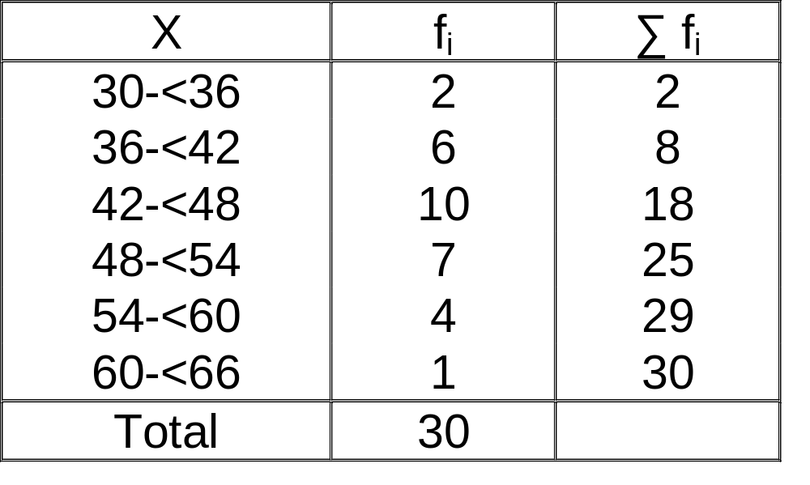
Example
Find the lower and upper quartiles of given data table.
Onur Doğan 2016-2017

Slide 10
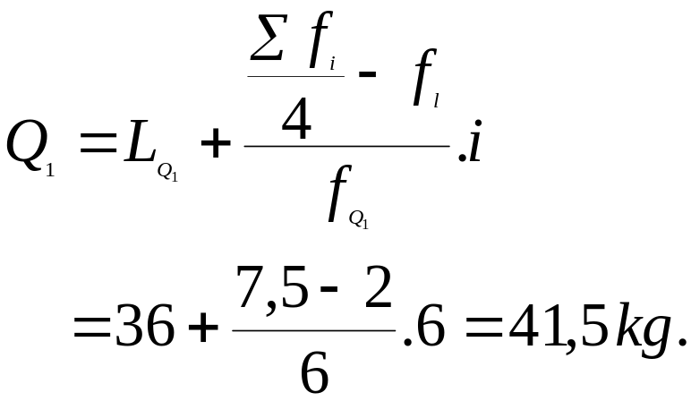
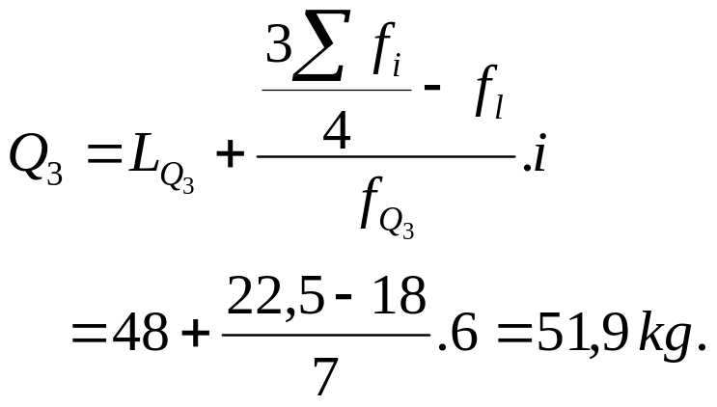
Example
36-<42
48-<54
Onur Doğan 2016-2017

Slide 11
Mean Absolute Error
Mean Absolute Error: The mean of the absolute values of the deviations from the mean:
1
∑
Mean
absolute
error
=
|
x
−
x
|
n
Onur Doğan 2016-2017

Slide 12
Example
Calculate the MAE of given data below;
X: 72, 81, 86, 69, 57
Onur Doğan 2016-2017

Slide 13
Mean Absolute Error
MAE for Frequency Distributions, Grouped Data?
Onur Doğan 2016-2017

Slide 14
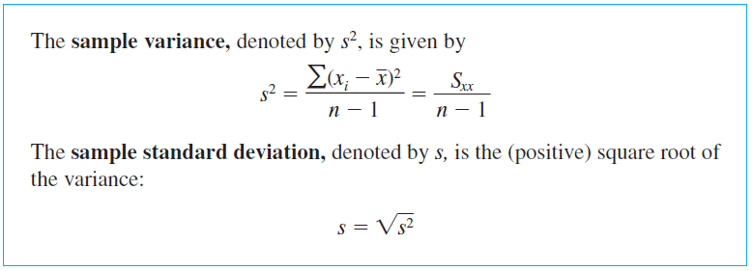
SD and Variance
Onur Doğan 2016-2017

Slide 15
Example
Example: Find the 1) variance and 2) standard deviation for the data {5, 7, 1, 3, 8}:
Solutions:
First:
x
=
1
(
5
+
7
+
1
+
3
+
8
)
=
4
.
8
5
x
x
−
x
(
x
−
x
)
2
5
0.2
0.04
7
2.2
4.84
1
-3.8
14.44
3
-1.8
3.24
8
3.2
10.24
Sum:
24
0
32.08
Onur Doğan 2016-2017

Slide 16
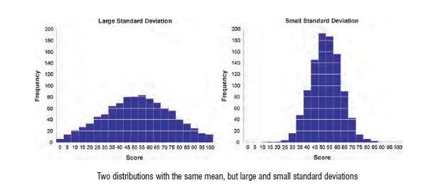
SD and Variance
Onur Doğan 2016-2017

Slide 17
SD and Variance
SD for Frequency Distributions, Grouped Data?
Onur Doğan 2016-2017

Slide 18
Example
X | f
8-12 | 2
12-16 | 4
16-20 | 2
20-24 | 4
Find the mean, MAE and SD of given data above.
Onur Doğan 2016-2017

Slide 19

The Coefficient of Variability
For group A, it is calculated that the mean age is 21 with a standard deviation of 3. For group B, the mean age is 41 with a standard deviation of 5.
Onur Doğan 2016-2017

Slide 20
Box-and-Whisker Display
Box-and-Whisker Display: A graphic representation of the 5-number summary:
The five numerical values (smallest, first quartile, median, third quartile, and largest) are located on a scale, either vertical or horizontal
The box is used to depict the middle half of the data that lies between the two quartiles
The whiskers are line segments used to depict the other half of the data
One line segment represents the quarter of the data that is smaller in value than the first quartile
The second line segment represents the quarter of the data that is larger in value that the third quartile
Onur Doğan 2016-2017

Slide 21
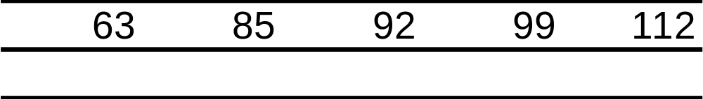





Example
Example: A random sample of students in a sixth grade class was selected. Their weights are given in the table below. Find the 5-number summary for this data and construct a boxplot:
63 64 76 76 81 83 85 86 88 89 90 91 92 93 93 93 94 97 99 99 99 101 108 109 112
Solution:
Onur Doğan 2016-2017

Slide 22
Boxplot for Weight Data
6
0
7
0
8
0
9
0
1
0
0
1
1
0
Onur Doğan 2016-2017

Slide 23
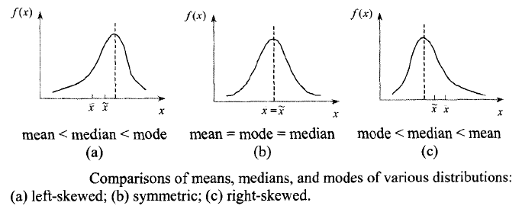
Skewness
Onur Doğan 2016-2017

Slide 24

Pearson's skewness coefficient
Onur Doğan 2016-2017

Slide 25
Example
It’s been understood that, in a hosptial patients’ average hospital stay is 28, median is 25 and mode is 23 (days). And the standard deviation calculated as 4,2.
Define the skewness type, find the pearson coefficient and interpret it.
Onur Doğan 2016-2017

Slide 26
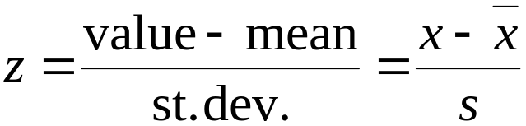
z-score
z-Score: The position a particular value of x has relative to the mean, measured in standard deviations. The z-score is found by the formula:
Notes:
Typically, the calculated value of z is rounded to the nearest hundredth
The z-score measures the number of standard deviations above/below, or away from, the mean
z-scores typically range from -3.00 to +3.00
z-scores may be used to make comparisons of raw scores
Onur Doğan 2016-2017

Slide 27
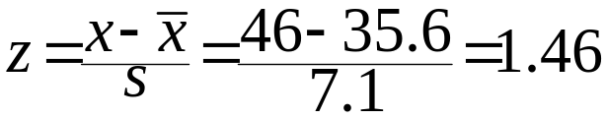
Example
A certain data set has mean 35.6 and standard deviation 7.1. Find the z-scores for 46 and 33:
Solutions:
46 is 1.46 standard deviations above the mean
x
−
x
33
−
35
.
6
z
=
=
=
0
.
37
s
7
.
1
33 is 0.37 standard deviations below the mean.
Onur Doğan 2016-2017

Slide 28
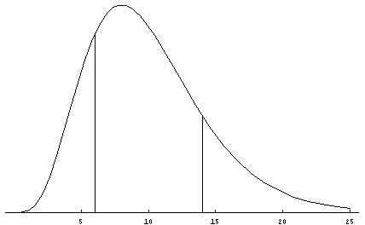
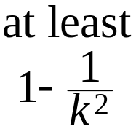


Chebyshev’s Theorem
Chebyshev’s Theorem: The proportion of any distribution that lies within k standard deviations of the mean is at least 1 − (1/k²), where k is any positive number larger than 1. This theorem applies to all distributions of data.
Illustration:
Onur Doğan 2016-2017

Slide 29
Example
The average check at a local restaurant is $36 with standard deviation of $6. What is the minimum percentage of checks between $27 and $45?
Onur Doğan 2016-2017

Slide 30
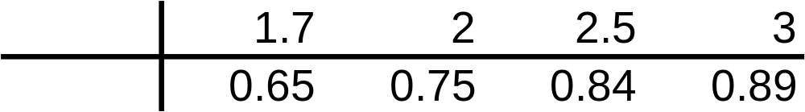


Important Reminders!
Chebyshev’s theorem is very conservative and holds for any distribution of data
Chebyshev’s theorem also applies to any population
The two most common values used to describe a distribution of data are k = 2, 3
The table below lists some values for k and 1 - (1/k²):
Onur Doğan 2016-2017

Slide 31
Example
At the close of trading, a random sample of 35 technology stocks was selected. The mean selling price was 67.75 and the standard deviation was 12.3. Use Chebyshev’s theorem (with k = 2, 3) to describe the distribution.
Solutions:
Using k=2: At least 75% of the observations lie within 2 standard deviations of the mean:
Using k=3: At least 89% of the observations lie within 3 standard deviations of the mean:
Onur Doğan 2016-2017

